Slide 1

CVMA 48-7
Crisis Intervention

Slide 2
PURPOSE
Be able to self-assess and respond to the Triple A of stress and trauma
Use de-escalation techniques and engagement strategies to protect yourself and your family
Build trust with family and friends and ASK for help-You do not even need to say it out loud:
  Hey, want to BBQ? I just need to be around people.
  Go for a ride? I’m getting bored being at home all the time.
  What are you doing? Need some help?
Notes:
Sometimes we get overwhelmed by life. We all experience stress in one way or another. We need to be able to identify those moments and take actions to reduce any negative outcome.

Slide 3
Stress
Have you experienced stress, anxiety or even post traumatic stress?
What did that feel like?
How did it affect you, short term and long term?
How did it affect your family and friends, short term and long term?

Slide 4
What is Post Traumatic Stress?
A disorder in which a person has difficulty recovering after experiencing or witnessing a terrifying event. Such as combat or a serious accident.
The condition may last months or years, with triggers that can bring back memories of the trauma accompanied by intense emotional and physical reactions.
Symptoms may include nightmares or unwanted memories of the trauma, avoidance of situations that bring back memories of the trauma, heightened reactions, anxiety, or depressed mood.
Treatment includes different types of trauma-focused psychotherapy as well as medications to manage symptoms.

Slide 5
Protective Factors Risk Factors
Resilience Previous suicide attempt *
Connectedness Mental health condition *
Social and peer support Substance use disorder *
Coping and problem-solving skills Access to lethal means (e.g., firearm)
Ability to adapt to change Social isolation *
Self-esteem and sense of purpose Chronic disease or disability
Meaning in life History of physical or sexual abuse
Culturally appropriate mental Family history of suicide
Health and wellness services Exposure to traumatic events in adulthood
Sources of continued care

Slide 6
Definition of Violence
Physical violence.
Verbal threats.
Intimidation.
Behaviors that are disruptive and/or generate a concern for the personal safety of family, self and first responders.
Violence can also include actions not intended to cause others harm. Such as throwing items or breaking property.

Slide 7
Universal Considerations about Violence
Remember that no specific diagnosis or type of person predicts future post traumatic stress
Provide person-centered care.
Anyone can become depressed or violent.
Assume there has been prior trauma.
Trauma is any negative life event that occurs in a position of relative helplessness. People who have experienced trauma may be highly sensitive to certain stimuli that trigger memories of the traumatic event, inducing a state of agitation.

Slide 8
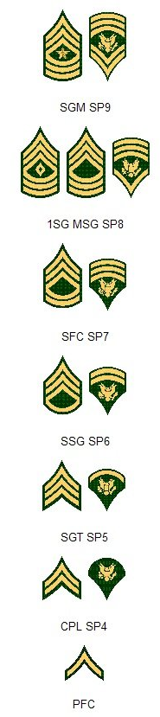
Special Considerations: Veterans
Their feelings about their time in service may or may not be positive.
Acknowledge their experience is difficult.
Help them find ways to control of their symptoms in a safe way.
Inquire about their accomplishments, if appropriate.
Ask about suicidal thoughts or self harm.
Survivor’s Guilt is a real thing, but not a reason to hurt yourself.
Be honest-Do not have secrets. Say what is on your mind
Veterans do not like to ask for help!

Slide 9

We all have our own struggles-Do not keep them secret
Medical conditions
Behind on bills
Family drama
Legal woes
Death in the family
Feeling unwanted or unappreciated
Want a family, but still single
Worried about the future
Can’t support your family
I promise you-That if you can name your struggle, we can help you overcome it!

Slide 10
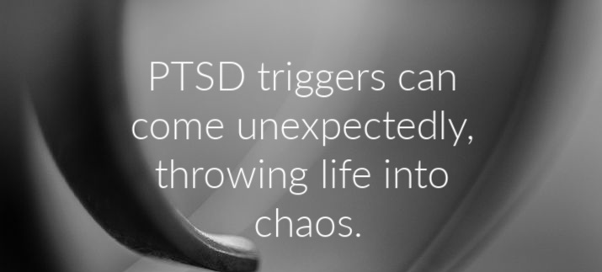
Behavioral Escalation: Triggers
Also known as "activators" or "stressors."
Any stimulus that impacts our behavior.
Individualized experiences and different for everyone.
Can impair judgment. Some people lack insight about their reactions to triggers.
In the context of mental illness, usually means something that has brought on or worsened symptoms.

Slide 11
Behavioral Escalation: Triggers
What are some of your own examples of triggers?
External Trigger Examples
Internal Trigger Examples
Sensations (sounds, smells, tastes, sights, etc.).
Time-related (times of day, specific days, holidays).
Specific locations or events.
Relational (arguments, changes in relationship, rejection).
Media (songs, TV, movies, news, etc.).
Memories (such as a traumatic event).
Emotions and feelings (anxiety, anger, sadness, loneliness, overwhelmed, vulnerable, etc.).
Internal physical sensations (muscle tension, pain, etc.).

Slide 12
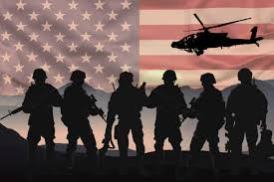
Warning Signs
What are some warning signs of escalation?
It is important to understand that you need to be able to say the problem out loud. If you cannot name the problem, you will have difficulty understanding that it is even a problem.

Slide 13
Body Language-For you and them
Body language differs from person to person: Age, gender and culture
People are strongly aware of your body language.
Be aware that 80%-90% of communication is through body language, especially during a crisis.
Approaching straight on or with hands behind the back appear very threatening.
Keep your hands out in the open, not crossed or in pockets.
Keep a neutral body stance, this will help keep the situation from escalating further.
Watch for abrupt changes in their stance or body language
Hands: Clenching fists, prepping clothing for a fight
Eyes: Scanning around, Staring blankly, not making eye contact

Slide 14
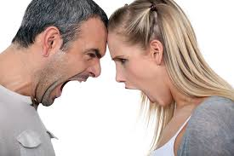
Warning Signs of Escalation: Verbal Cues
Signs that may occur quickly without warning
Speaking loudly or yelling.
Swearing.
Threatening or aggressive tone of voice.
Verbal threats.

Slide 15
Warning Signs of Escalation: Non-Verbal Cues
Long Term Signs
Happen quickly, maybe with no warning
Neglect of clothing and/or hygiene.
Expression of fear, nervousness, or anxiety.
Social withdrawal.
Low interest in activities.
Fixed stare.
Arms held tightly across chest.
Clenched fists.
Heaving breathing.
Pacing, restlessness, agitation.
Aggressive/threatening posture.
Throwing objects.
Sudden change in behavior, such as eye contact.

Slide 16

Trauma Response and Trauma Informed Care
Brain functions are a balance between thinking (cerebral cortex), emotion (limbic system), and instinct (cerebellum).
Trauma and/or traumatic triggers can short-circuit rational thinking.
Leads to a state of physiological hyperarousal or FIGHT-FLIGHT-FREEZE response.
Goal is to help people transition from fight/flight/freeze to "rest and digest."

Slide 17
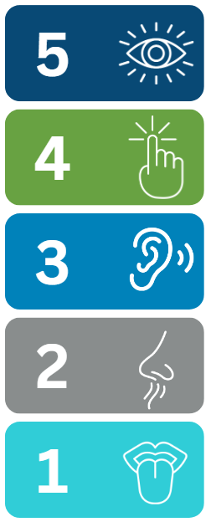
5-4-3-2-1 Grounding Techniques to help get back to the here and now
Name 5 things you can see.
Name 4 things you can feel.
Name 3 things you can hear.
Name 2 things you can smell.
Name 1 thing you can taste.

Slide 18
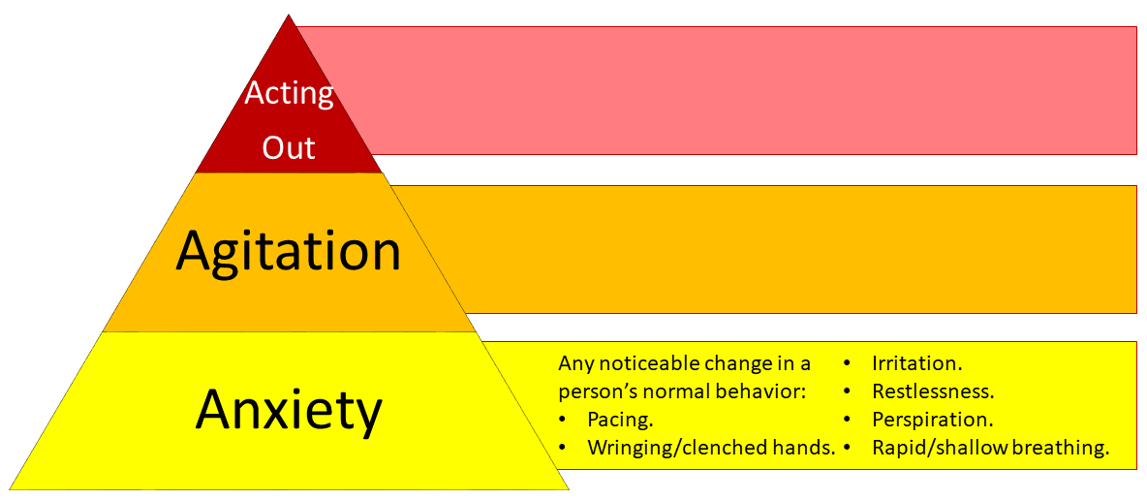
Stages of Escalation: The Triple A of Stress Reaction
Follows untreated or heightened agitation. Individual displays: -Physical violence towards self or others
-Inability to problem solve
Indications of untreated or heightened state of anxiety: -Yelling -Swearing -Threats
-Increased restlessness
-Limited ability to problem solve

Slide 19
Sensory Grounding-Tips
Hold an ice cube.
Bite into a lemon or other fruit.
Place hands in water.
Pick up item near you and note its shape, feel, and texture.
Inhale a strong scent.
Slowly trace an outline around your fingers.
Stroke a pet.

Slide 20
Positive Affirmations
I am enough.
I'm learning to love myself.
I choose happiness.
I have strength and power to take whatever comes my way.
I can do challenging things.
I am grateful for this day and the many possibilities it affords.

Slide 21
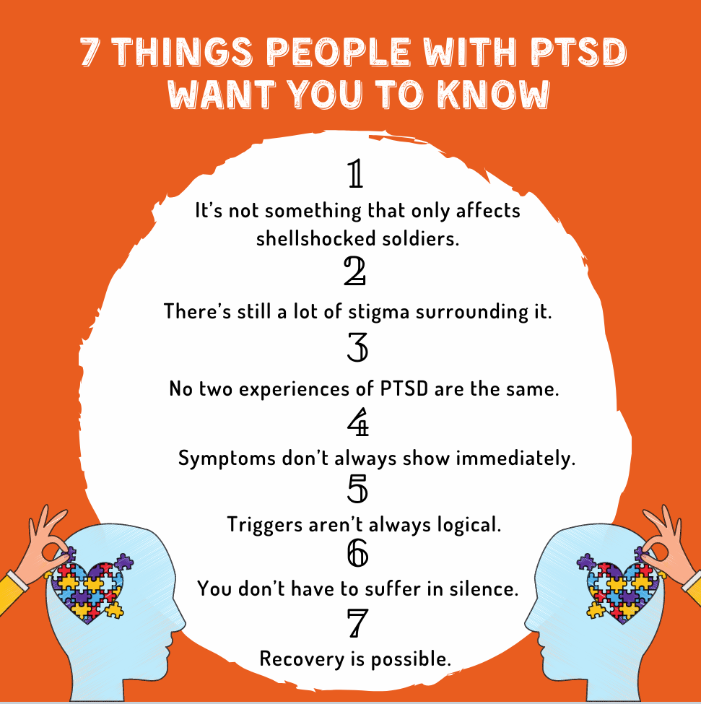
Engagement Pillars-What family and friends can do to help
General engagement practices.
Generate hope.
Do something useful.
Validate.
What do these look like in practice?

Slide 22
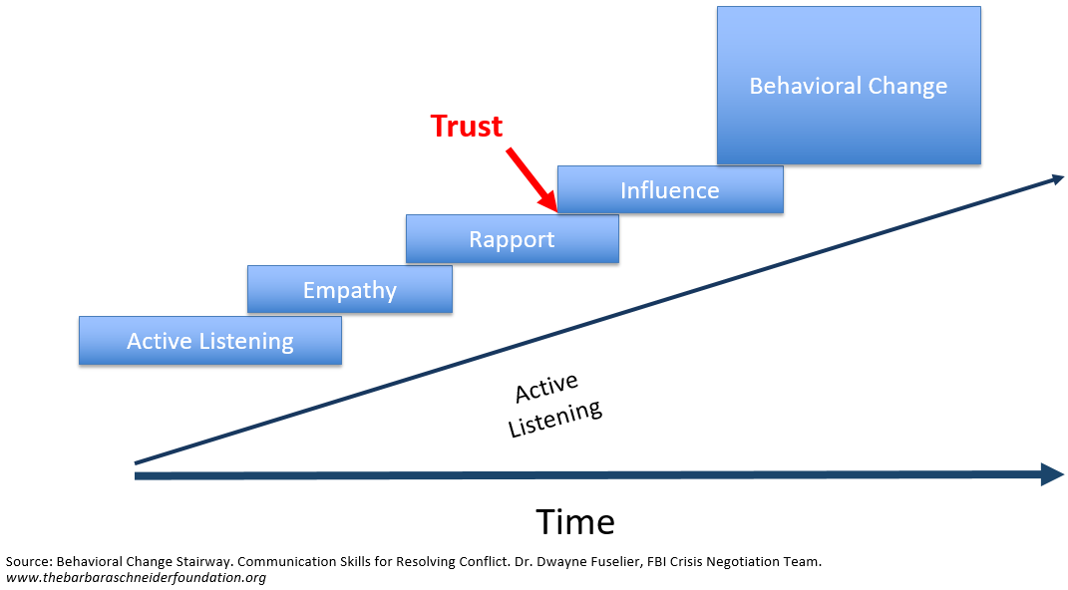
How to bring about positive Behavior Change
It could take hours, days, weeks or even months!

Slide 23


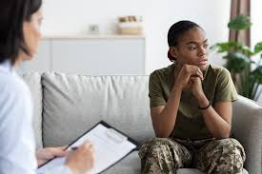
Responding to Escalation
What are some ways you can constructively respond to escalating behavior?

Slide 24
De-Escalation Strategies
Respect personal space.
Do not be provocative or argumentative.
Establish verbal contact-Establish that rapport. Rapport builds trust. Trust
Be concise.
Identify wants and feelings.
REACH OUT TO OTHERS!
Listen closely to what the individual is saying; pay attention.
Agree (when you can) or agree to disagree.
Offer choices and optimism.
Provide hope.
Debrief-Discuss with family members

Slide 25
De-Escalation Do's
Be honest
Initiate active listening.
Comply with reasonable requests.
Reduce stimuli
Get some rest
Eat healthy
Exercise regularly
Spend time with family
Spend time with friends
Spend time working on yourself
Write down your thoughts
Tell others what you are thinking
Listen patiently and paraphrase.
Problem-solve and offer solutions instead of taking control.
Ask how you can help.
Affirm their positive qualities.
Offer a face-saving way out.
Notes:
Let the person take ownership of their treatment / care plan.

Slide 26


De-Escalation Dont's
Do not engage in self-destructive behaviors: (Risk Taking)
  Excessive drinking
  Gambling
  Smoking
  Driving too fast / unsafe
  Starting arguments / fights
  Lash out at others
  Cutting / harming yourself
  Over medicating
  Handling firearms

Slide 27

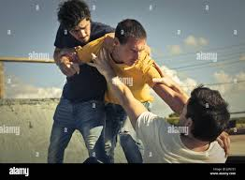
De-Escalation Don'ts
Challenge the individual's thinking.
Argue.
Threaten.
Intensely question.
Use sarcasm.

Slide 28
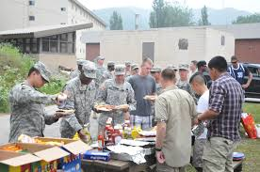
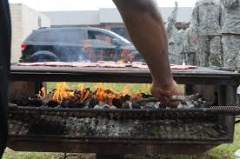
Be PROACTIVE
Establish a strong friendship with a few trusted friends and family
Reach Out to others regularly.
All things in moderation
Idle hands are the devil’s workshop-Meaning do not overthink things. Instead, stay busy being constructive

Slide 29

Support for Coping
CRISIS HOTLINE: 9-8-8
Spiritual Care:
External resources:
Coping strategies
  Just hang out
  Motorcycle ride
  Family time
  Meditate / Pray
  Hike / Exercise

Slide 30

Situational Awareness
Situational awareness: monitoring people and places around you for potential risks.
Document and communicate to other healthcare workers during shift-to-shift report, hand-off, and safety tiers.

Slide 31
When helping others-
Universal Precautions for Personal Safety
Ask yourself: "Do I feel safe?"
Assess your environment. Be aware of improvised weapons.
Keep an open path for your exit.
Leave or call for help, if you feel threatened.
Use your best judgment regarding the safest course of action.
Defend yourself against assault by the person.
Watch for escalating behavior.
Maintain a safe distance whenever possible.
Team interventions are the best and safest approach.

Slide 32
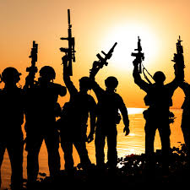
Message from –Doc Tackett
Please, please remember, my very dear Friend, that you are loved and respected.
Whatever you are going through is certainly very difficult-but the burden is always
easier, if more people help carry it. I do not want you to ever hurt yourself. Reach out and
someone WILL answer!
I pray that the Good Lord watch over you and your family and give you the strength
you need to handle your business. The transition from military to civilian life is hard enough
without us overthinking it and acting out rashly when faced with extreme challenges.
We can persevere and succeed if we just reach out and connect with our Battle Buddies!
-Doc Tackett

