Slide 1

Triage Refresher

Slide 2
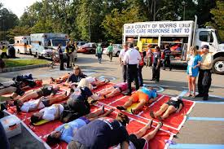
Purpose
To refresh seasoned Emergency Response Team members in the concepts and operations that will be needed to function during a massive casualty incident.

Slide 3
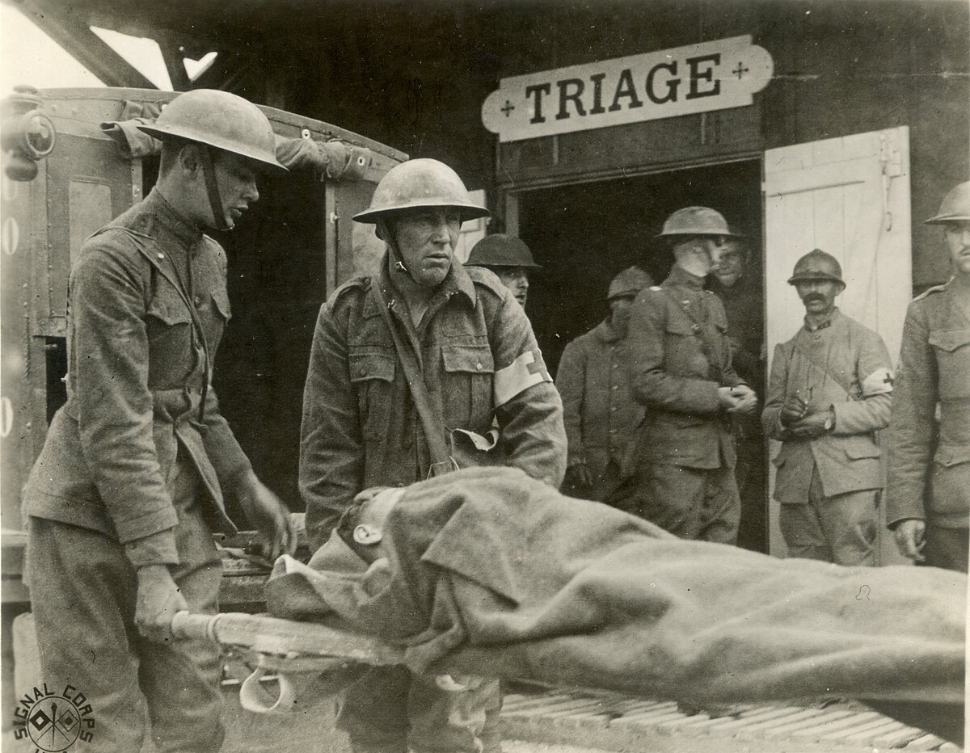
Definition of TRIAGE: The 4 R’s
French verb: To sort or to choose
It’s the process by which patients are classified according to the type of injury and the urgency of their conditions.
This process is designed to get the RIGHT Patient to the RIGHT Place at the RIGHT Time with the RIGHT Care Provider

Slide 4
The concept of Triaging patients:
To provide the most effective care to the greatest number of patients
Triage of ALL patients should be less than 5 minutes, unless you cannot find them, then triage as you find them or as they show up

Slide 5
Why would we need to triage?
If a DISASTER occurred, either natural or human made, this may produce patients in numbers which exceed available resources. Even a small number of serious, multi-system trauma patients can easily overwhelm our resources.
The key to disaster management is to provide care to those who are in the greatest need first. And just importantly, not provide care to those who have little or no chance of survival.

Slide 6
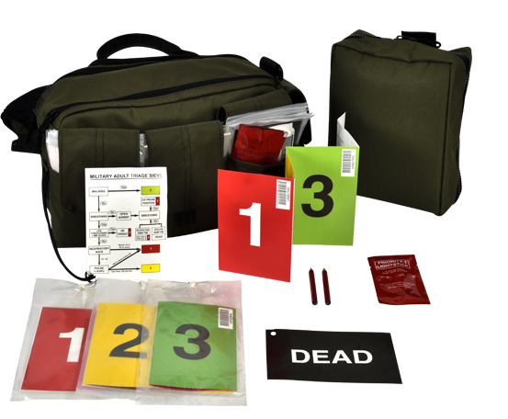
Report to the EOC (Emergency Operations Center)
Sign In
Get your assignment
Check your supplies and equipment-Based upon your assignment
Go to your area with your Team. Battle Buddy up

Slide 7
Universal Steps for Emergency Response
CHECK-Scene Safety. Identify yourself. Perform Triage to the injured quickly-Only open airways and apply tourniquets as needed
CALL-Call for the Evacuation Teams to move the injured to the Treatment Areas. Call for those who can walk-To walk to the Green treatment area
CARE-Care for the Red patients first, Care for the Yellow patients and then Care for the Green patients (Or have them Care for themselves)
CONTROL-Control the flow of patients, the vehicle evacuation route, the supplies, the manpower, the crowd/onlookers

Slide 8
Components of a Triage Team
The Actual Triage Team members-With Triage tags or colored tape – 1 to 4 members. After triaging, they become Evacuation or Treatment Team members
The Evacuation Team-With litters, stretchers, blankets, etc. – At least 4 members. Traffic control, Crowd control,
The Treatment Team-With first aid supplies – At least 2 members

Slide 9
Types of patients: Priority and Color Code
1 RED Immediate/Critical: Need surgery within 2 hours.
2 YELLOW Urgent/Delayed: Need to be seen within 4 hours
3 GREEN Non-Critical/Minor: Usually, the first to arrive. Can wait up to 8 hours
4 BLACK Expected to not survive. Keep separate from the others
Chemically Contaminated patients: Keep separate from the others until Decontamination is complete. Then Triage

Slide 10
Each Section should have a Leader
RED: Reassess patients every 3 to 5 minutes
YELLOW: Reassess patients every hour
GREEN: Maybe Reassess patients every hour
BLACK: Continuous monitoring of bodies to maintain dignity and property

Slide 11
TRIAGE-Determining the color category
RED YELLOW GREEN BLACK
Airway Open or not
Breathing Effort, rate, depth, skin color, sound
Circulation Capillary refill, radial pulses
Disability (Neurogenic) Conscious or Unconscious
Then Check:
Pain Score: On a scale of 1 to 10, 10 being the worst
Bleeding and prior medical issues: Under control or not
Mechanism of Injury: Fall, sudden stop, explosion, etc.

Slide 12
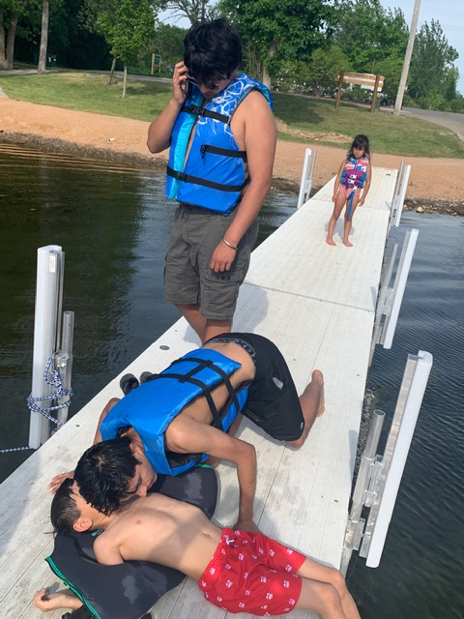
Immediate – RED Priority 1
Account for EVERYONE. Sign In sheet (CERT Triage)
Stabilize Life Threats and Treat for Shock
Vital Signs
Check Breathing: 12 to 20 and regular
Check Pulse: 60 to 100 and regular
Circulation: Control major bleeding, Capillary refill less than 2 seconds
Prep for transport
Complete Triage Tag
Report to EOC

Slide 13
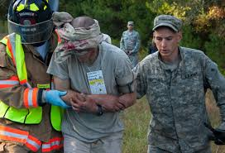
Urgent – YELLOW Priority 2
Stabilize injuries and Treat for Shock.
Vital Signs
Check Breathing: 12 to 20 and regular
Check Pulse: 60 to 100 and regular
Circulation: Capillary refill less than 2 seconds
Prep for transport
Complete Triage Tag

Slide 14
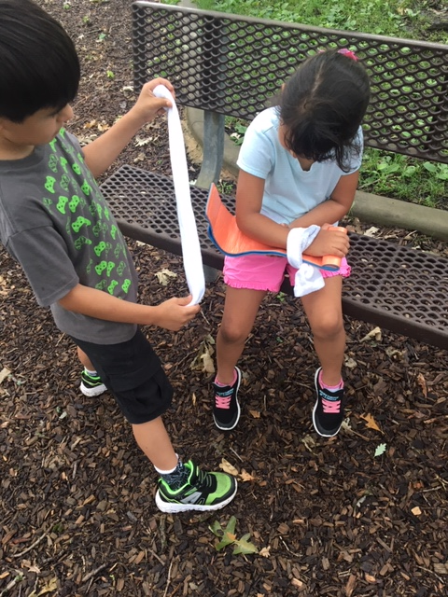
Non-critical – GREEN Priority 3
Crowd Control
Self Aid
Buddy Aid
Check Breathing: 12 to 20 and regular
Check Pulse: 60 to 100 and regular
Circulation: Capillary refill less than 2 seconds
Complete Triage Tag

Slide 15
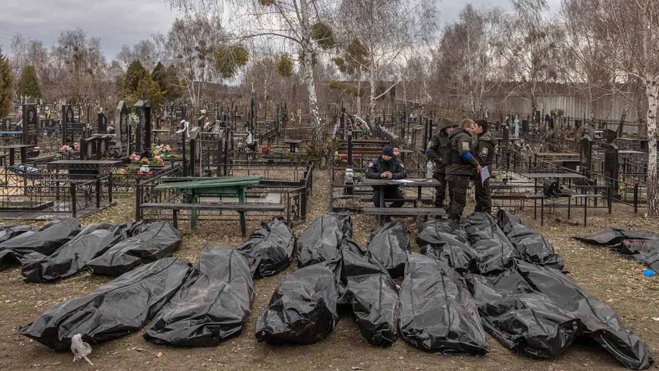
Expectant – BLACK Priority 4
Cover body
Safeguard property
Complete Triage Tag

Slide 16
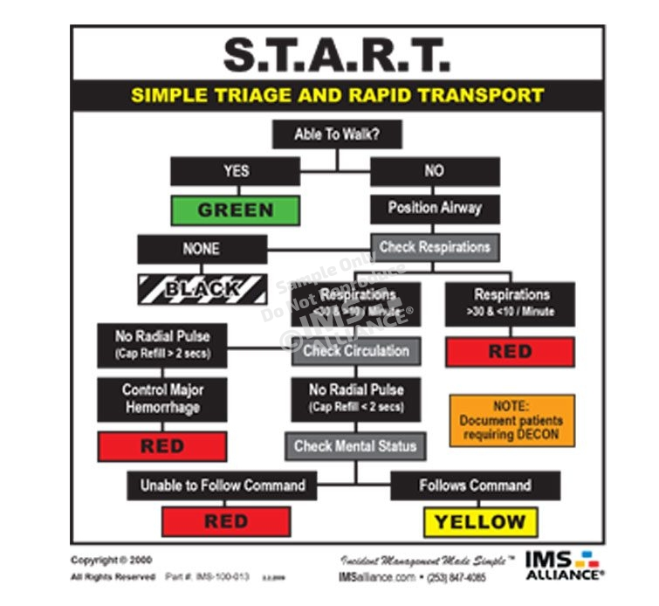
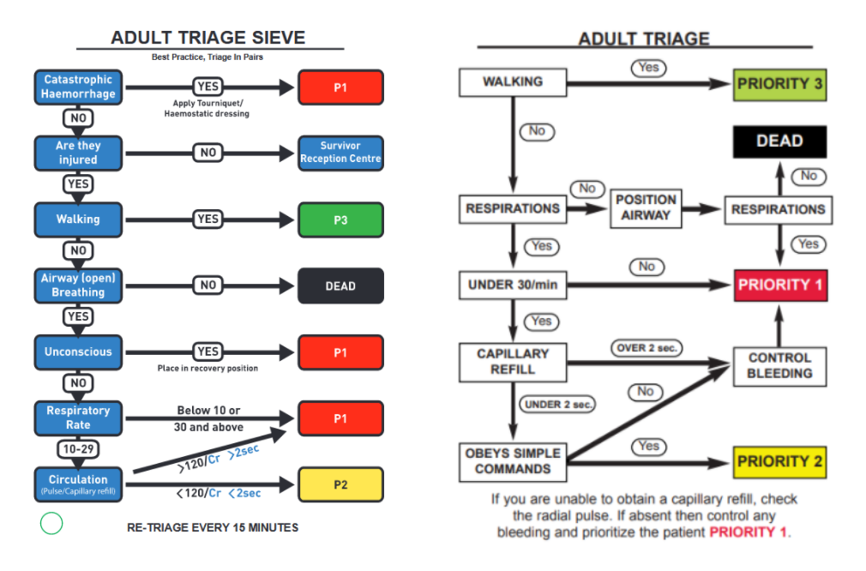
Flow chart

Slide 17
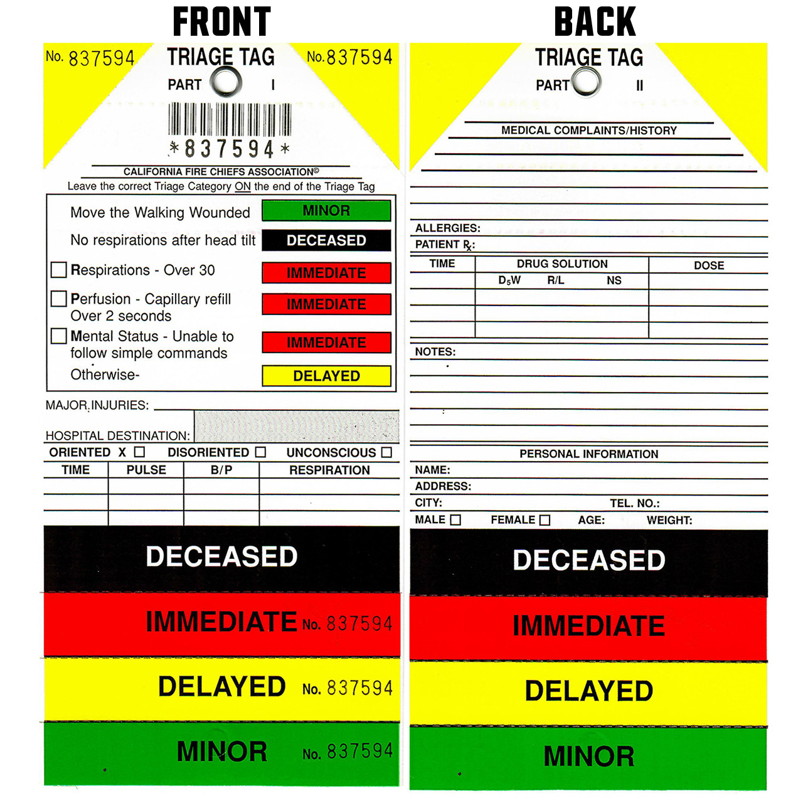
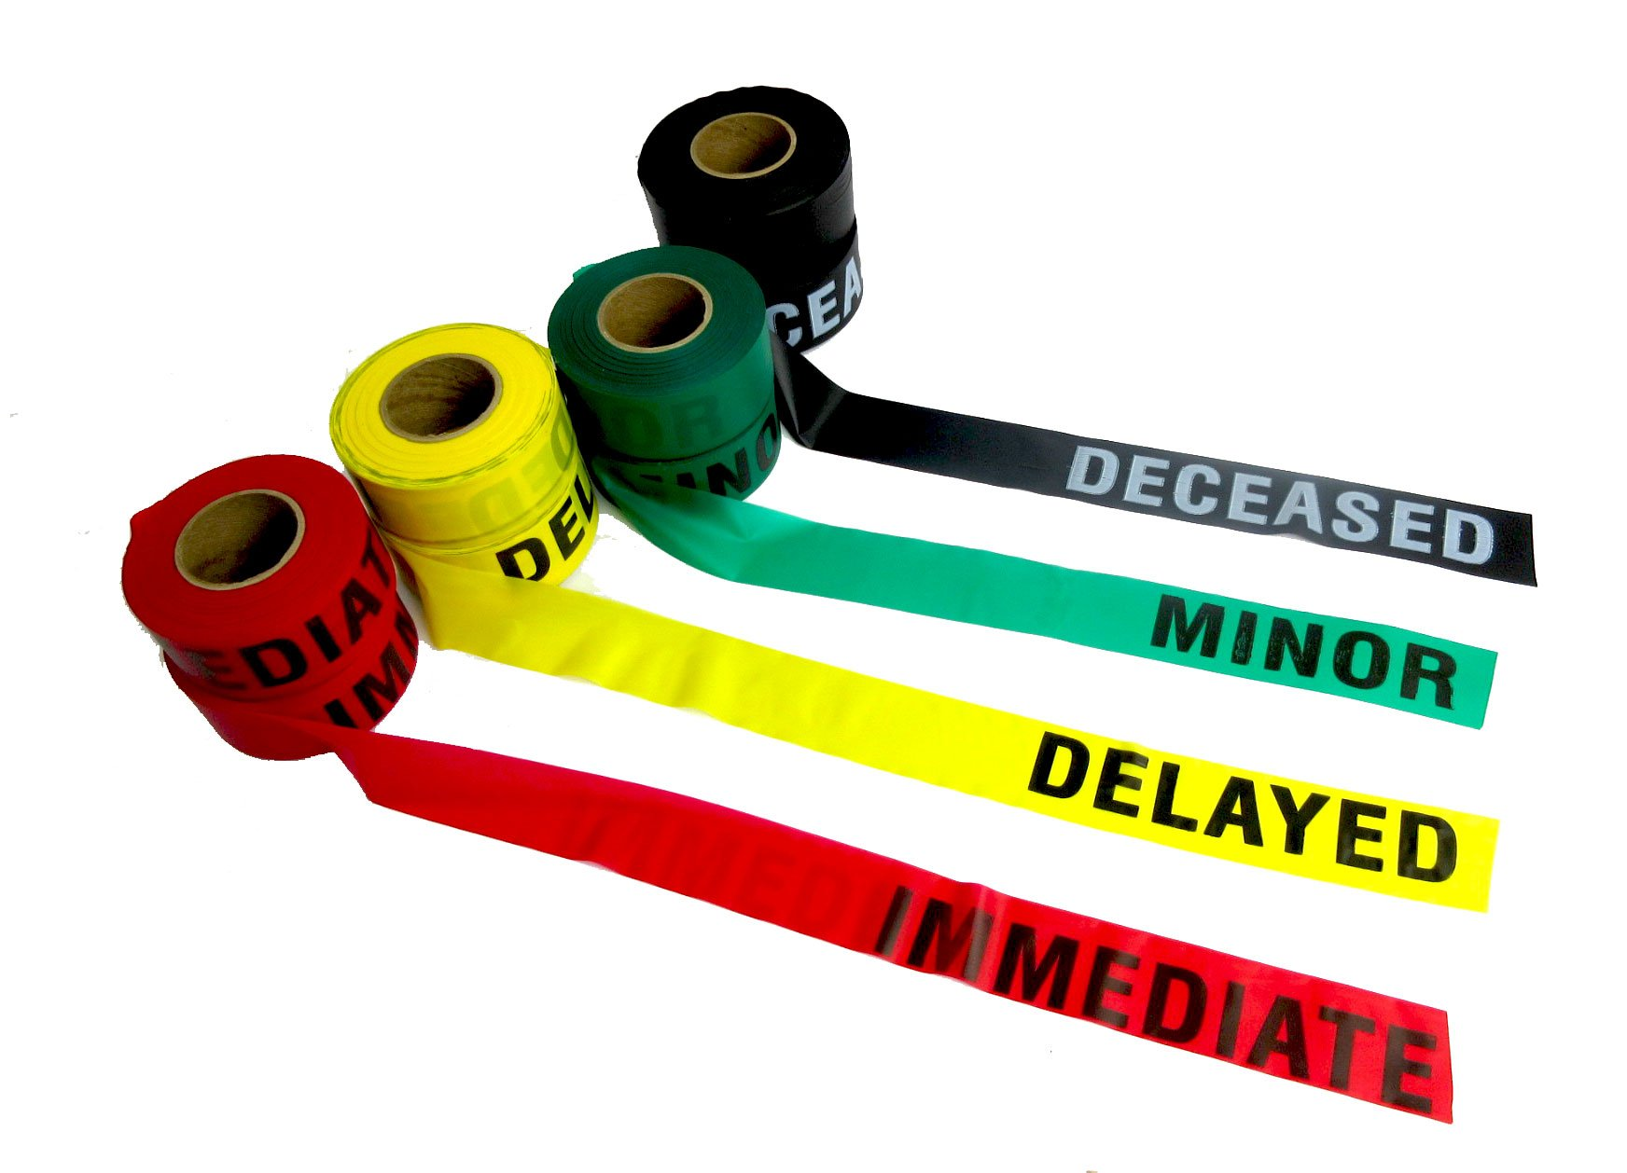
Triage Tag / Tape

Slide 18
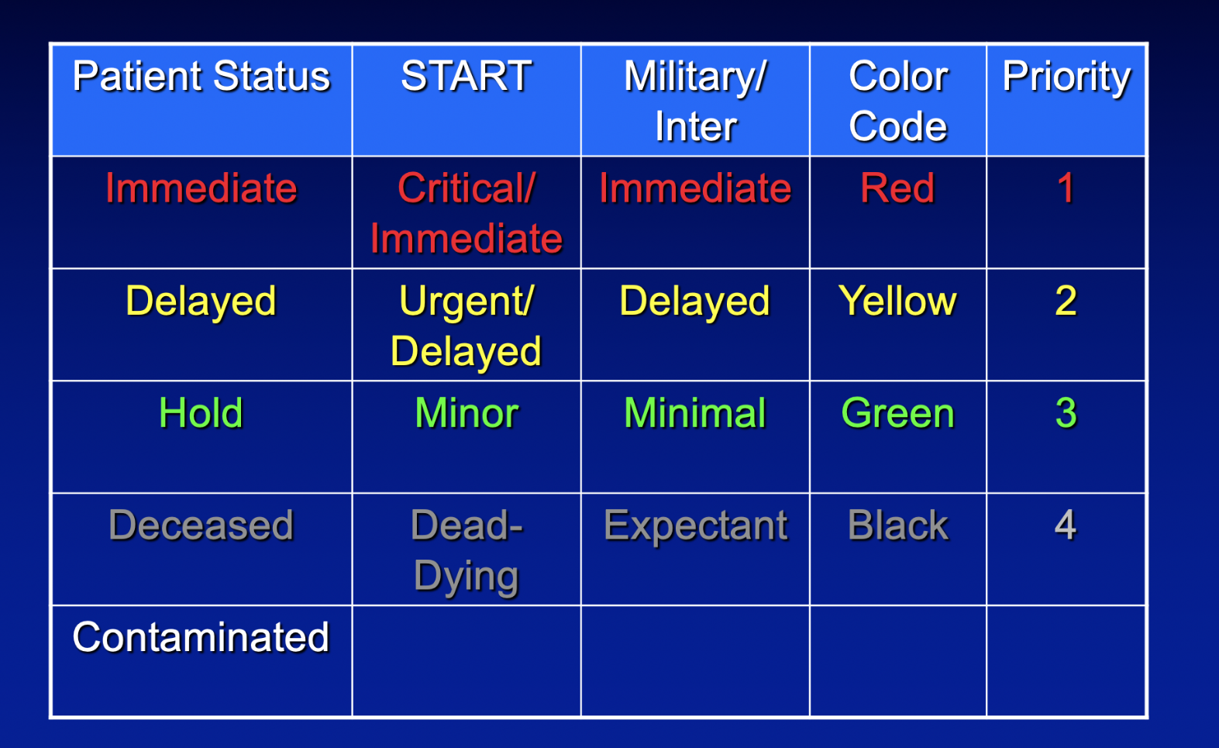
Triage Categories

Slide 19
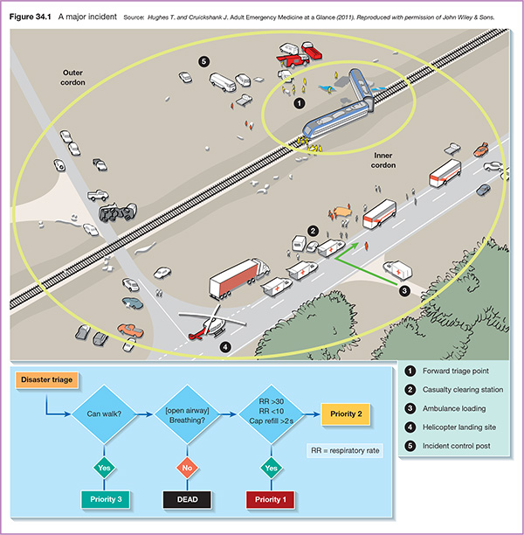
INCIDENT LAYOUT

Slide 20
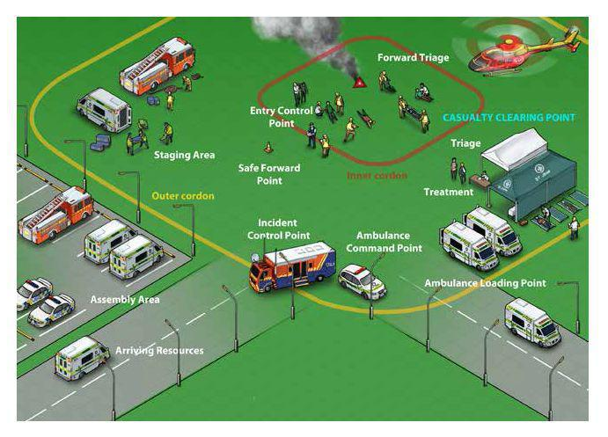
INCIDENT LAYOUT

Slide 21
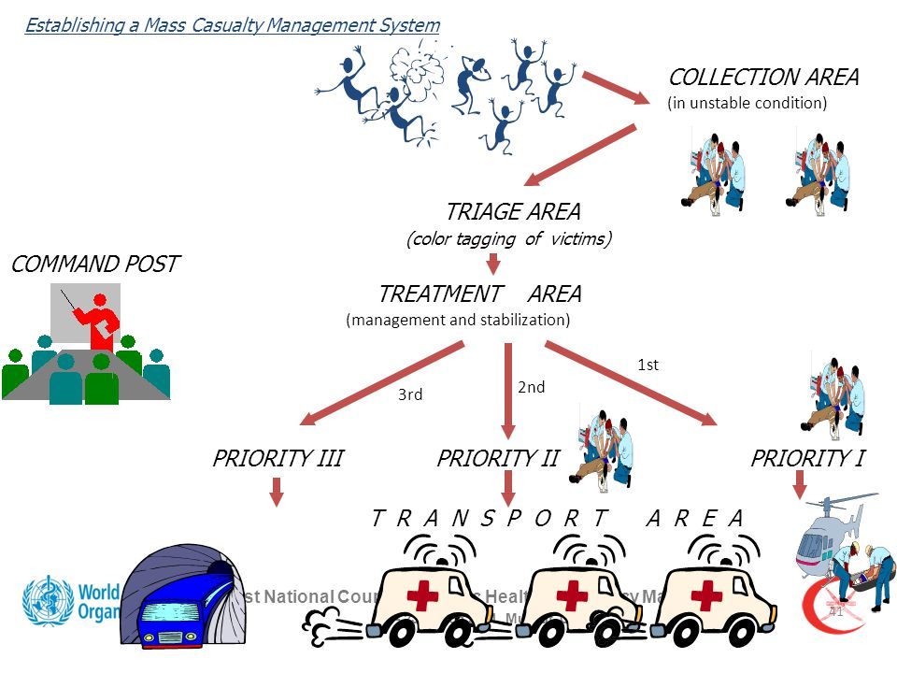
INCIDENT LAYOUT

Slide 22
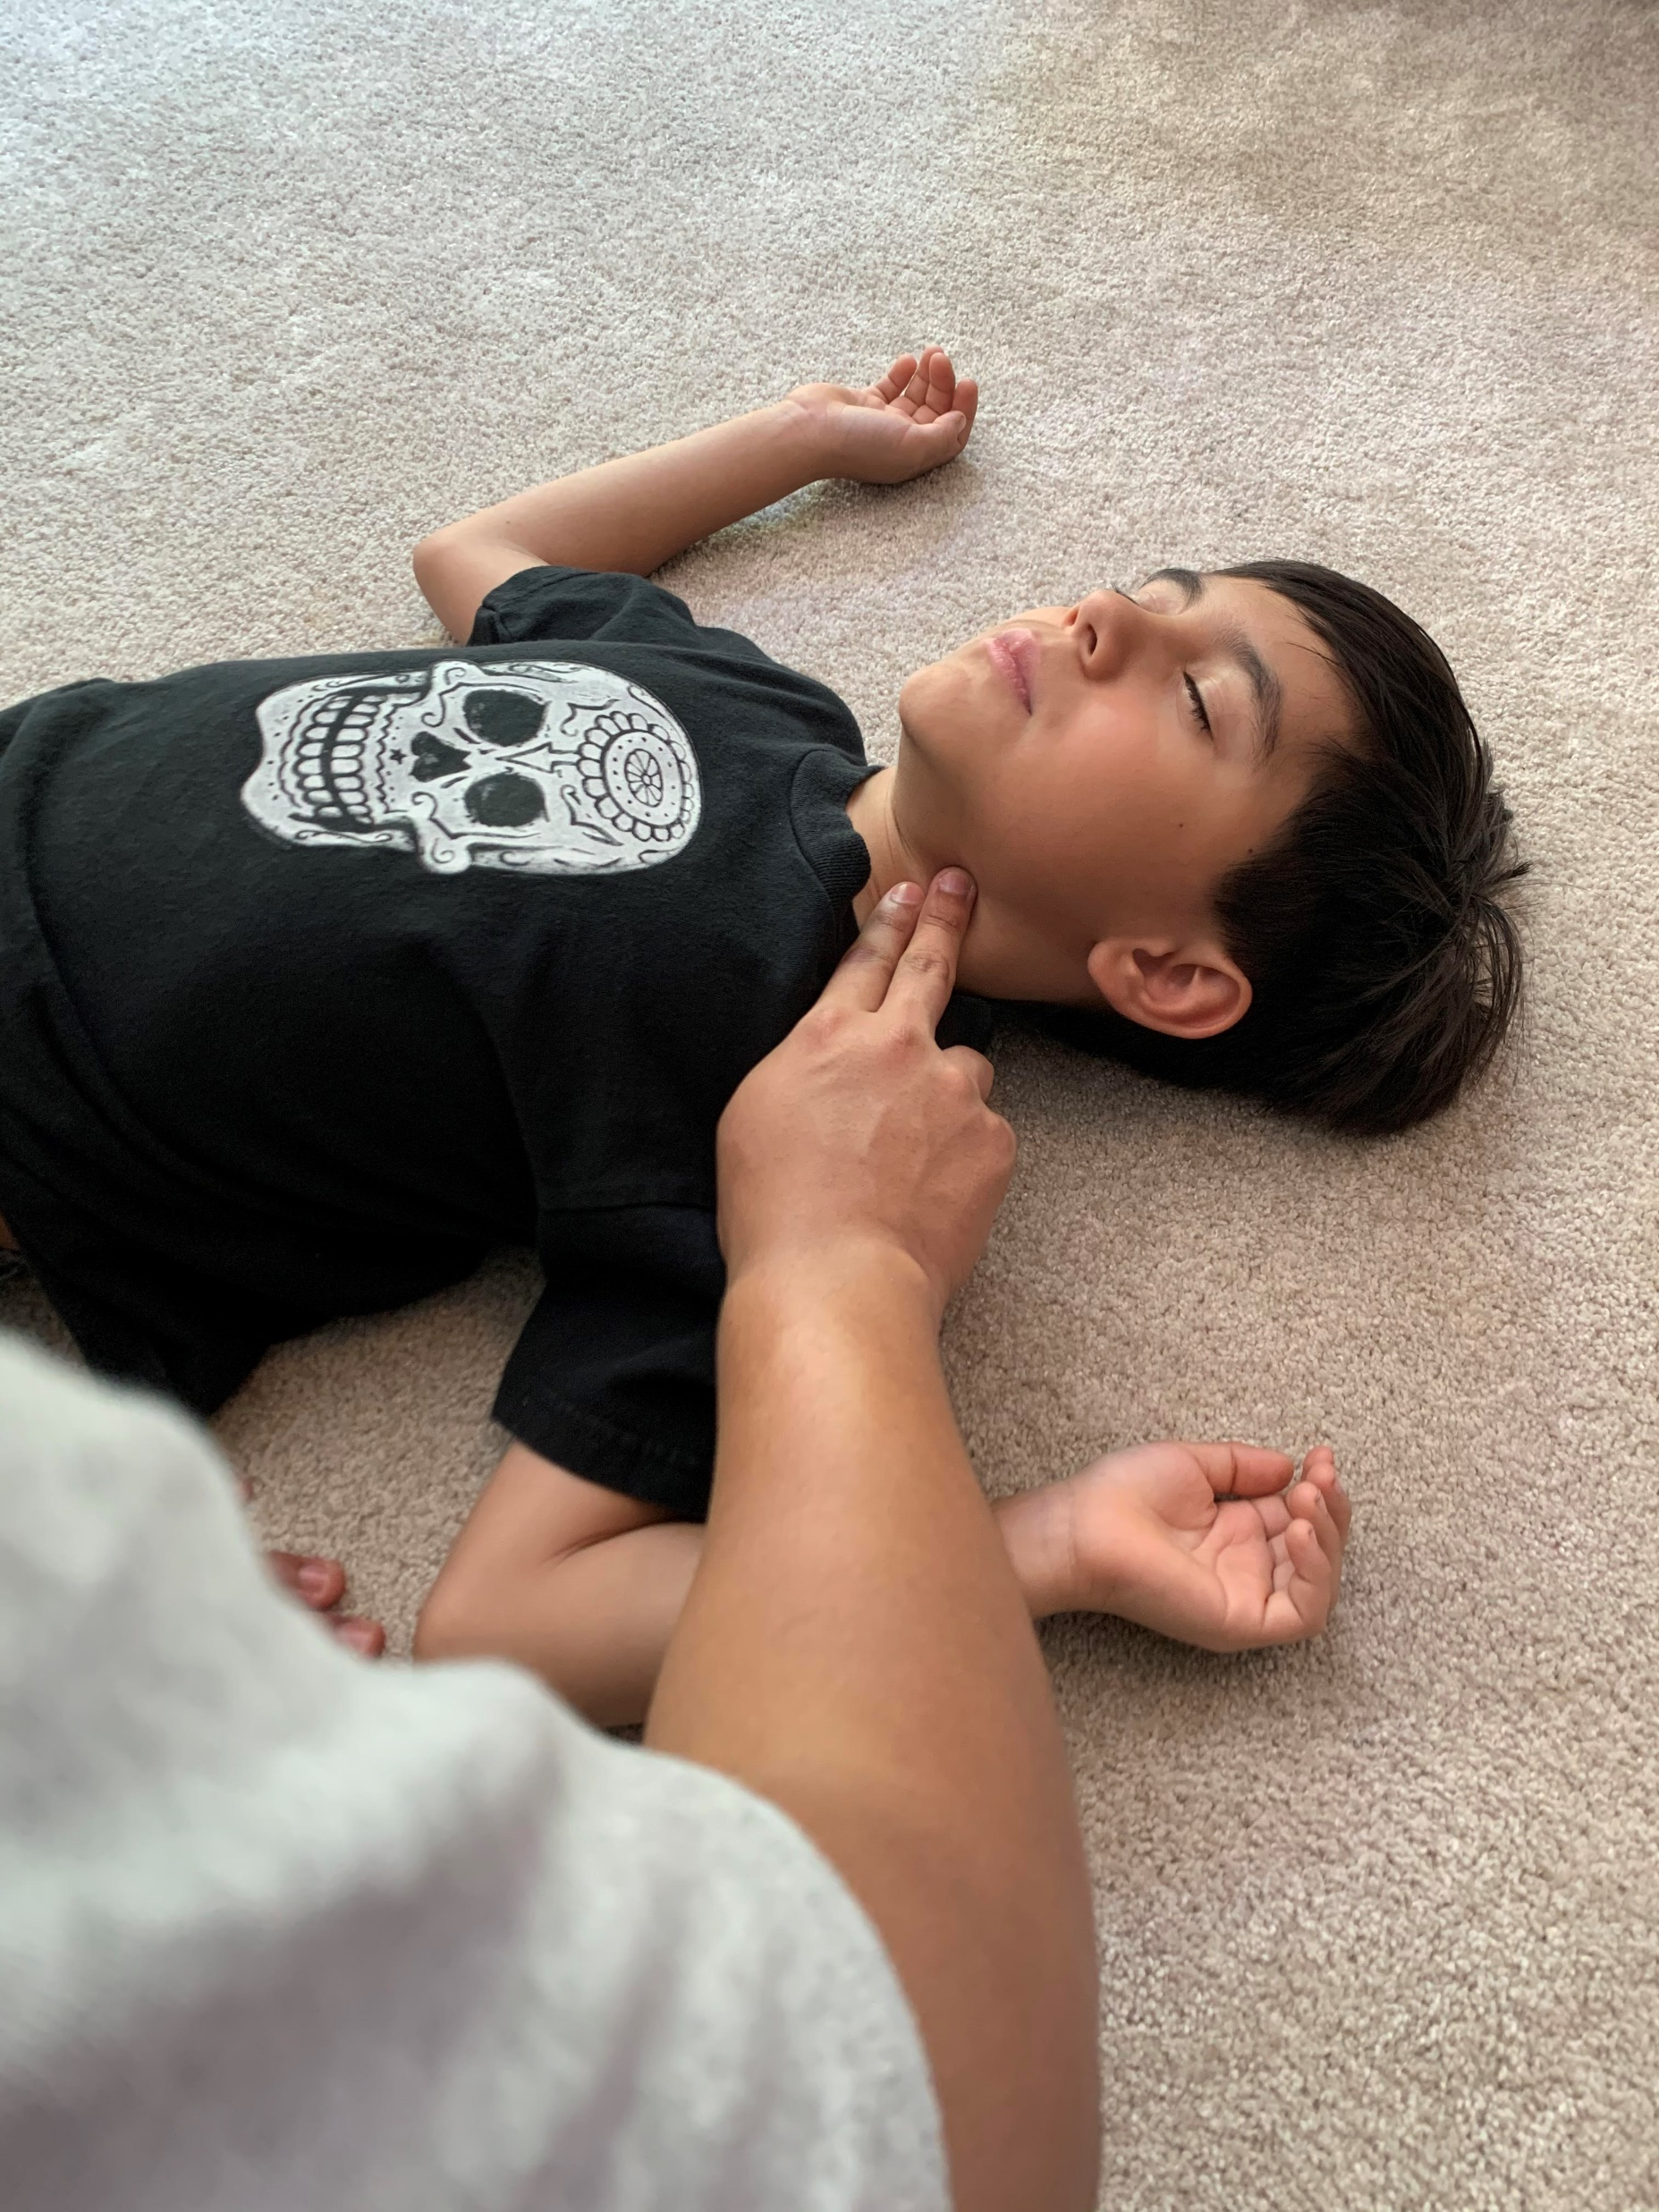
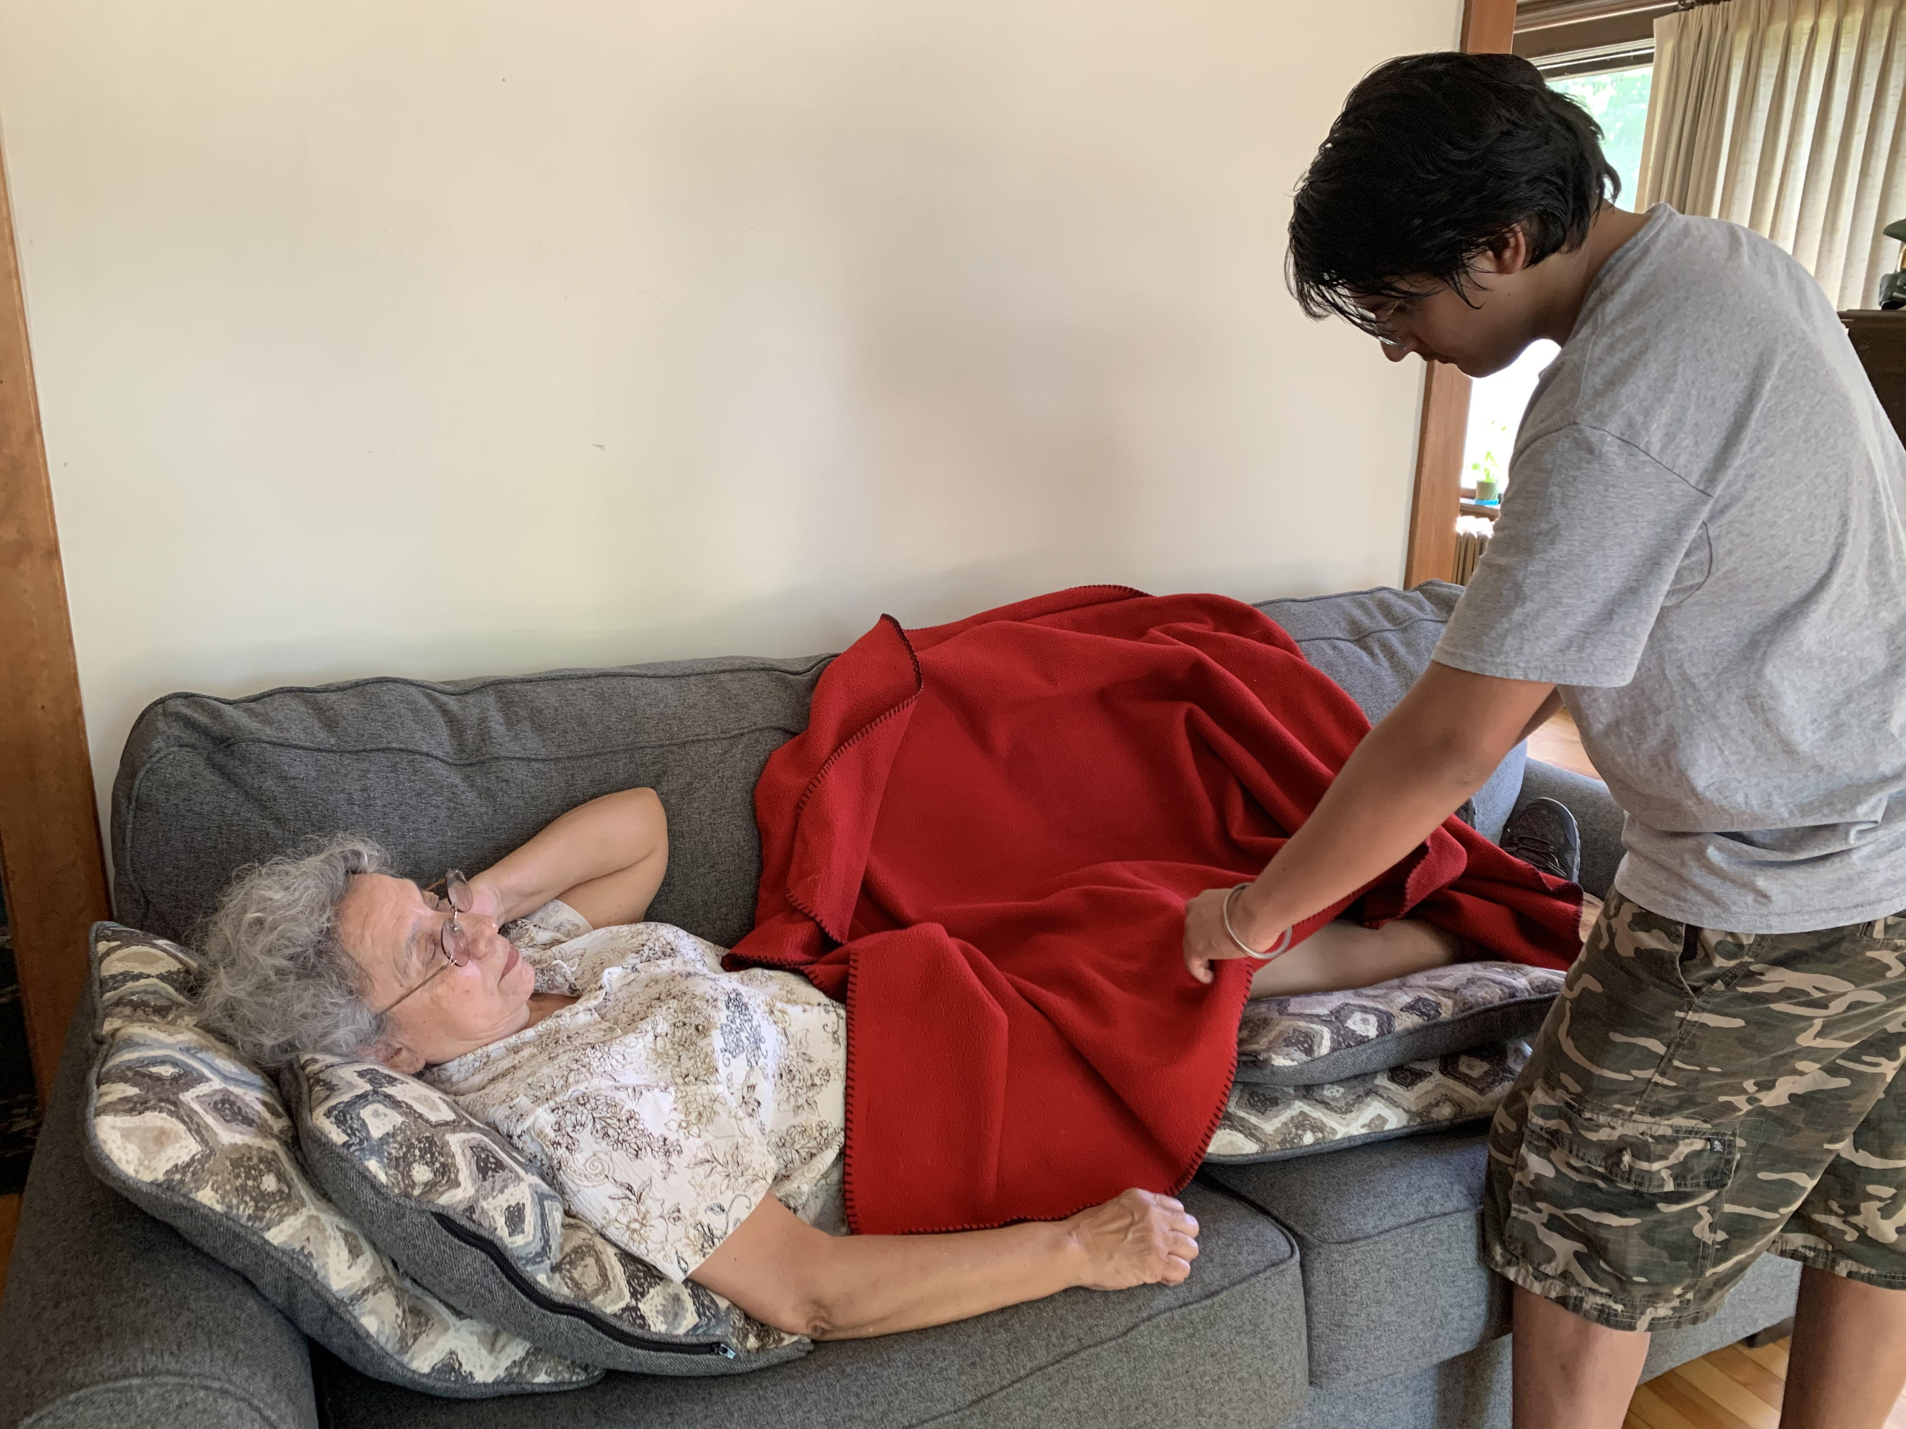
How would you Triage the following:
No pulse
Pain to leg, unable to walk, pulse intact, capillary refill is 2 seconds

Slide 23
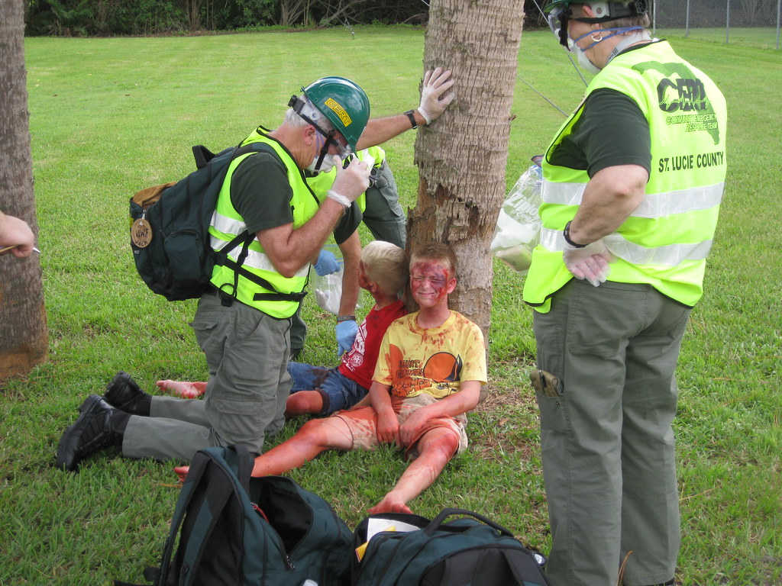
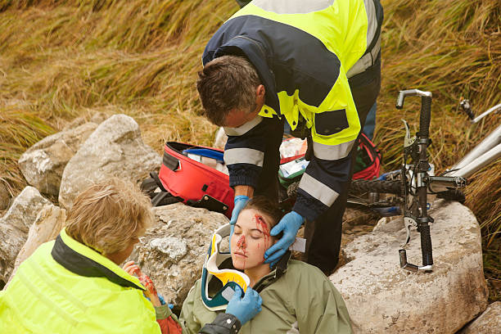
How would you Triage the following:
Burns to face and body, Cuts to face and body, airway problems
Unconscious, breathing 12X/Min, cuts to head

Slide 24
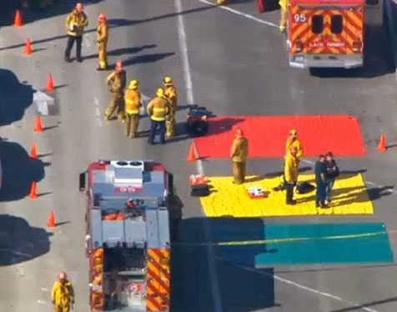
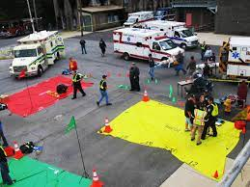
Notice the colored tarps and colored flags???

Slide 25
 |  | WASECA COUNTY C.E.R.T. |  |  |  |  | Date:
 |  | PATIENT TRACKER |  |  |  |  | Team Leader:
 |  |  |  |  |  |  | Location:
 | Name: Last, First | Triage Cat. | MB A-B-C | Injury Type | C-Spine | Tourniquet | Time Left Area | Disposition
1 |  | R Y G B | MB A - B - C | D C A P B T L S | Y / N | Y N / | am pm
 | Notes:
2 |  | R Y G B | MB A - B - C | D C A P B T L S | Y / N | Y N / | am pm
 | Notes:
3 |  | R Y G B | MB A - B - C | D C A P B T L S | Y / N | Y N / | am pm
 | Notes:
4 |  | R Y G B | MB A - B - C | D C A P B T L S | Y / N | Y N / | am pm
 | Notes:
5 |  | R Y G B | MB A - B - C | D C A P B T L S | Y / N | Y N / | am pm
 | Notes:
Triage Category | MB A-B-C |  | DCAPBTLS |  |  | C-Spine | Disposition
Red-Immediate | Major Bleeding |  | Deformities | Burns |  | Yes or No | Where did they go
Yellow-Urgent | Airway |  | Contusions | Tenderness
Green-Delayed | Breathing |  | Abrasions | Lacerations |  | Tourniquet
Black-Expectant | Circulation |  | Punctures | Swelling |  | Time applied

Slide 26
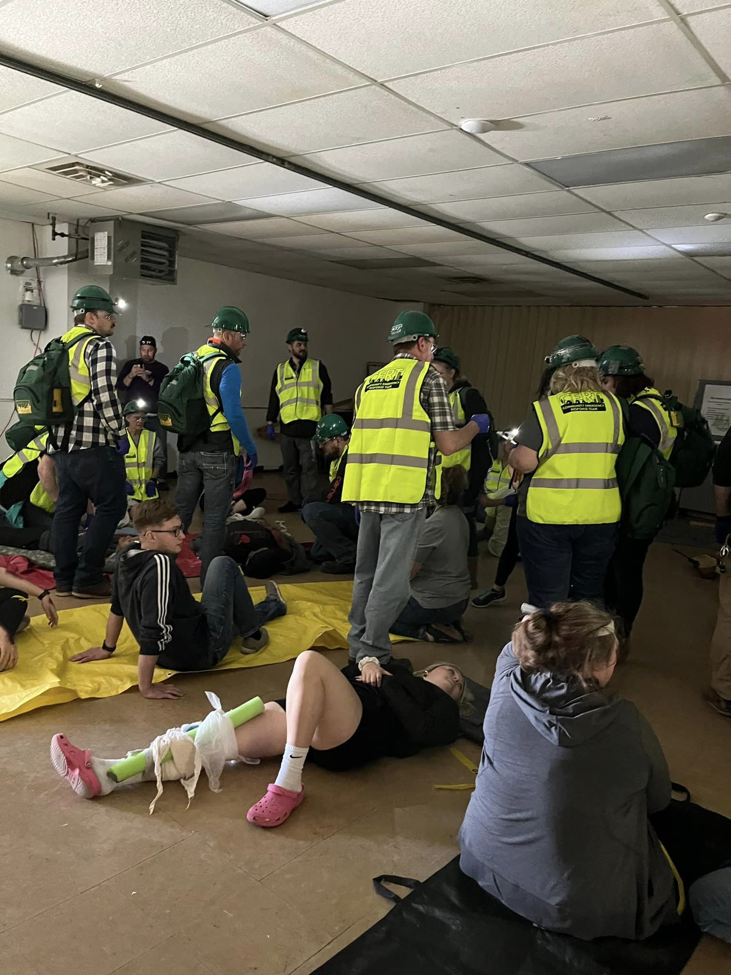
Any Questions???
Thank you for all you do!!!

